Slide 1


St. John’s Lutheran Church
1000 Helena Ave.
Helena, MT 59601
(406) 442-6270
August 3, 2025
Pastor Keith Weatherford, Presiding
(Materials used with permission under One License, License Number A-704356.)

Slide 2
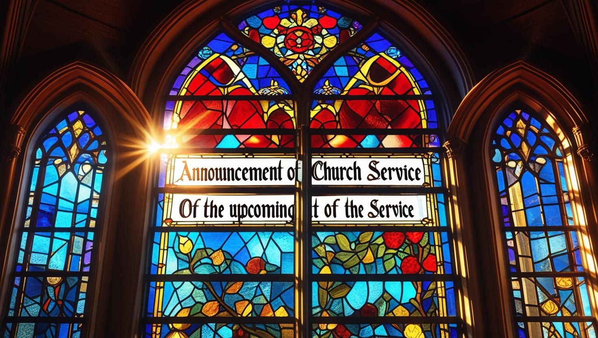
Welcome and Announcements

Slide 3
*Confession and Forgiveness
P:
In the name of the Father, and of the ☩ Son, and of the Holy Spirit.
Amen.
C:

Slide 4
P:
Baptized into Christ, let us confess our sin. Merciful God,
you free us to love others, but we neglect our neighbors and follow our own way. You lead us by the Spirit of joy and peace, but we turn away from the abundant life you offer.
C:

Slide 5
You surround us with patience, kindness, and generosity,
but we grow weary in doing what is right. In your mercy, forgive us.
Do not give up on us. Heal us, break our bonds, and show us the path of life.
Amen.

Slide 6
P:
You belong to Christ Jesus
and you are God’s children through faith. In the cross of ☩ Christ, and through the power of the Holy Spirit, your sins are forgiven. Clothed with Christ, you are a new creation.
Amen.
C:

Slide 7
*Opening Hymn:
“A Hymn of Glory Let us Sing”
ELW # 393

Slide 8
1. A hymn of glory let us sing!
New hymns throughout the world shall ring: Alleluia! Alleluia!
Christ, by a road before untrod,
ascends unto the throne of God.
Alleluia! Alleluia!
Alleluia, alleluia, alleluia!

Slide 9
2. The holy apostolic band
upon the Mount of Olives stand,
Alleluia! Alleluia!
and with his faithful foll'wers see
their Lord ascend in majesty.
Alleluia! Alleluia!
Alleluia, alleluia, alleluia!

Slide 10
3. To whom the shining angels cry,
"Why stand and gaze upon the sky?"
Alleluia! Alleluia!
"This is the Savior!" thus they say,
"this is his glorious triumph day!"
Alleluia! Alleluia!
Alleluia, alleluia, alleluia!

Slide 11
4. "You see him now, ascending high
up to the portals of the sky."
Alleluia! Alleluia!
"Hereafter Jesus you shall see
returning in great majesty."
Alleluia! Alleluia!
Alleluia, alleluia, alleluia!

Slide 12
5. O risen Christ, ascended Lord,
all praise to you let earth accord:
Alleluia! Alleluia!
You are, while endless ages run,
with Father and with Spirit one.
Alleluia! Alleluia!
Alleluia, alleluia, alleluia!

Slide 13
*Apostolic Greeting
P:
The grace of our Lord Jesus Christ, the love of God,
and the communion of the
Holy Spirit be with you all.
And also with you.
C:

Slide 14
*Prayer of the Day
P:
Let us pray. Benevolent God,
you are the source, the guide, and the goal of our lives.
C:

Slide 15
Teach us to love what is worth loving, to reject what is offensive to you, and to treasure what is precious in your sight, through Jesus Christ, our Savior and Lord.
Amen.

Slide 16
Reading – Colossians 3:1-11
Life in Christ includes a radical reorientation of our values. Just as the newly baptized shed their old clothes and put on new garments, so Christians are called to let go of greed and take hold of a life shaped by God’s love in Christ.

Slide 17
¹ So if you have been raised with Christ, seek the things that are above, where Christ is, seated at the right hand of God. ² Set your minds on the things that are above, not on the things that are on earth, ³ for you have died, and your life is hidden with Christ in God.

Slide 18
⁴ When Christ who is your life is revealed, then you also will be revealed with him in glory.
⁵ Put to death, therefore, whatever in you is earthly: sexual immorality, impurity, passion, evil desire, and greed (which is idolatry).

Slide 19
⁶ On account of these the wrath of God is coming on those who are disobedient. ⁷ These are the ways you also once followed, when you were living that life. ⁸ But now you must get rid of all such things: anger, wrath, malice, slander, and abusive language from your mouth.

Slide 20
⁹ Do not lie to one another, seeing that you have stripped off the old self with its practices ¹⁰ and have clothed yourselves with the new self, which is being renewed in knowledge according to the image of its creator.

Slide 21
¹¹ In that renewal there is no longer Greek and Jew, circumcised and uncircumcised, barbarian, Scythian, enslaved and free, but Christ is all and in all!
L:
The Word of the Lord.
Thanks be to God.
C:

Slide 22
*Gospel Acclamation
(DATH #15)
Al-le-lu-ia, al-le-lu - ia.
Al-le-lu-ia, al-le-lu - ia.
Al-le-lu-ia, al-le-lu - ia.
Al-le-lu-ia, al-le-lu - ia.

Slide 23
*Gospel – Luke 12:13-21
P:
The Holy Gospel according to Luke
chapter twelve, beginning with the thirteenth verse.
Glory to you, O Lord.
C:

Slide 24
*Gospel – Luke 12:13-21
In God’s reign, the “rich will be sent away empty.” Jesus uses a parable to warn against identifying the worth of one’s life with the value of one’s possessions rather than one’s relationship with God.

Slide 25
¹³ Someone in the crowd said to (Jesus,) “Teacher, tell my brother to divide the family inheritance with me.” ¹⁴ But he said to him, “Friend, who set me to be a judge or arbitrator over you?”

Slide 26
¹⁵ And he said to them, “Take care! Be on your guard against all kinds of greed, for one’s life does not consist in the abundance of possessions.” ¹⁶ Then he told them a parable: “The land of a rich man produced abundantly.

Slide 27
¹⁷ And he thought to himself, ‘What should I do, for I have no place to store my crops?’ ¹⁸ Then he said, ‘I will do this: I will pull down my barns and build larger ones, and there I will store all my grain and my goods.

Slide 28
¹⁹ And I will say to my soul, Soul, you have ample goods laid up for many years; relax, eat, drink, be merry.’ ²⁰ But God said to him, ‘You fool! This very night your life is being demanded of you. And the things you have prepared, whose will they be?’

Slide 29
²¹ So it is with those who store up treasures for themselves but are not rich toward God.”
P:
The Gospel of the Lord.
Praise to you, O Christ.
C:

Slide 30
Children’s Message and Sermon
Pastor Keith Weatherford,
Presiding
(Silence for Reflection)

Slide 31
“My Hope is Built on Nothing Less”
ELW # 597
1. My hope is built on nothing less
than Jesus' blood and righteousness;
no merit of my own I claim,
but wholly lean on Jesus' name.

Slide 32
Refrain:
On Christ, the solid rock, I stand;
all other ground is sinking sand,

Slide 33
2. When darkness veils his lovely face,
I rest on his unchanging grace;
in ev'ry high and stormy gale
my anchor holds within the veil.
Refrain; On Christ, the solid rock, I stand;
all other ground is sinking sand.

Slide 34
3. His oath, his covenant, his blood
sustain me in the raging flood;
when all supports are washed away,
he then is all my hope and stay.
Refrain; On Christ, the solid rock, I stand;
all other ground is sinking sand.

Slide 35
4. When he shall come with trumpet sound,
oh, may I then in him be found,
clothed in his righteousness alone,
redeemed to stand before the throne!
Refrain; On Christ, the solid rock, I stand;
all other ground is sinking sand.

Slide 36
*Apostles’ Creed
I believe in God, the Father almighty,
creator of heaven and earth.
I believe in Jesus Christ, God’s only
Son, our Lord, who was conceived
by the Holy Spirit, born of the virgin
Mary, suffered under Pontius Pilate,

Slide 37
was crucified, died, and was
buried; he descended to the dead.*
On the third day he rose again;
he ascended into heaven,
he is seated at the right hand of the
Father, and he will come to judge the living and the dead.

Slide 38
I believe in the Holy Spirit,
the holy catholic Church,
the communion of saints,
the forgiveness of sins,
the resurrection of the body,
and the life everlasting.
Amen.

Slide 39
*Prayers
P:
In solidarity with all creation, we join our voice to the voice of the whole church and pray for the needs of the world.

Slide 40
Prayer Response (each portion of the prayers
end with these words):
P: God of grace,
C: hear our prayer.

Slide 41
*The Peace is Shared
P:
As Christ welcomed everyone,
let us open our hearts and lives and be like Christ to everyone we meet. The peace of the Lord be with you.
And also with you.
C:

Slide 42

Offering
An offering is gathered for the mission of the church, including care of those in need. Online donations can be made at:
www.helenastjohns.org/donate

Slide 43
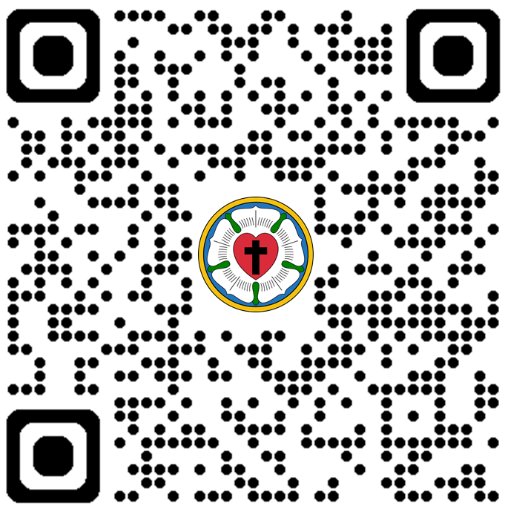
*OFERTORY HYMN
“I Will Sing New Songs”
Angela Conley
mezzo-soprano

Slide 44
*Offertory Prayer
P:
Let us pray. Creator God,
in your wisdom you bring forth all that is good and the harvest is plentiful.
C:

Slide 45
Strengthen us at your table with these gifts of the earth and our labor, that we may work for the good of all, through Jesus Christ, Our Savior.
Amen.

Slide 46
*The Great Thanksgiving
P:
The Lord be with you.
And also with you.
Lift up your hearts.
We lift them to the Lord.
Let us give thanks to the Lord our God.
It is right to give our thanks and praise.
C:
P:
C:
P:
C:

Slide 47
*Words of Institution
P:
Holy, mighty and merciful God, in great love you sent Jesus your Son, who reached out to heal the sick and suffering, who preached good news to the poor, and who, on the cross, opened his arms to all.

Slide 48
In the night in which he was betrayed, our Lord Jesus took bread and gave thanks; broke it, and gave it to his disciples, saying: Take and eat; this is my body, given for you.
Do this for the remembrance of me.

Slide 49
Again, after supper, he took the cup, gave thanks, and gave it for all to drink, saying: This cup is the new covenant in my blood, shed for you and for all people for the forgiveness of sin.
Do this for the remembrance of me.

Slide 50
Pour out upon us the spirit of your love, O Lord, and unite the will of all who share this heavenly food, the body and blood of Jesus Christ, our Lord: to whom, with you and the Holy Spirit, be all honor and glory, now and forever. Amen.

Slide 51
*The Lord’s Prayer
C:
Our Father in Heaven,
hallowed be your name,
your kingdom come,
your will be done,
on earth as in heaven.
Give us today our daily bread.

Slide 52
Forgive us our sins as we forgive
those who sin against us.
Save us from the time of trial and
deliver us from evil.
For the kingdom, the power, and
the glory are yours, now and
forever.
Amen.

Slide 53
*Invitation to Communion
P:
The Kingdom of God is set before you. Eat and Rejoice.
(We celebrate this meal together at Christ’s table, and all are welcome and encouraged to receive the forgiving and gracious presence of Christ in communion.
Ushers will invite you forward starting from the rear of the sanctuary.)

Slide 54
*In This Feast of Love ACS #962
1. In this feast of love,
in this feast of love,
Lord, you share your blood and your body,
Jesus, Lamb of God.

Slide 55
2. In this bread and wine,
in this bread and wine,
you have promised, Lord, to be with us,
Lamb of God divine.

Slide 56
3. Grant us peace, O Lord,
grant us peace, O Lord;
fill us with the joy of your Spirit,
ever-living Word.

Slide 57
*Prayer After Communion
P:
Let us pray. Mothering God, you gathered us to your table and we drank deeply of your grace. Send us out by your Spirit to love our neighbors as ourselves and proclaim your love in Jesus’ name.
C:
Amen

Slide 58
*Blessing
P:
The love of God abound in you; the grace of our Savior Jesus Christ fill your hearts; and the life of the Spirit ☩ bless you and give you peace.
C:
Amen

Slide 59
“We Know That Christ is Raised”
ELW # 449
1. We know that Christ is raised and dies no more.
Embraced by death, he broke its fearful hold,
and our despair he turned to blazing joy.
Hallelujah!

Slide 60
2. We share by water in his saving death.
Reborn, we share with him an Easter life,
as living members of our Savior Christ.
Hallelujah!

Slide 61
3. The Father's splendor clothes the Son with life.
The Spirit's fission shakes the church of God.
Baptized, we live with God the Three in One.
Hallelujah!

Slide 62
4. A new creation comes to life and grows
as Christ's new body takes on flesh and blood.
The universe restored and whole will sing:
Hallelujah!

Slide 63
*Dismissal
P:
Go in peace. Live by the Spirit.
Thanks be to God.
C:
“Growing in Grace, Walking by Faith, Serving in Love”

Slide 64

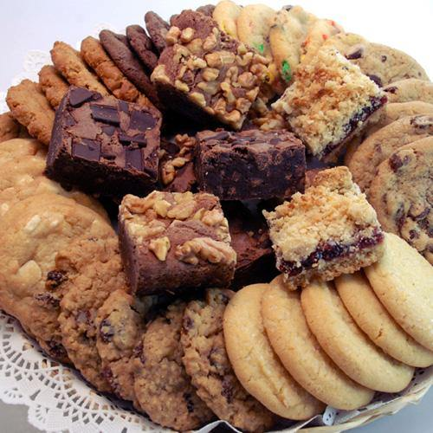
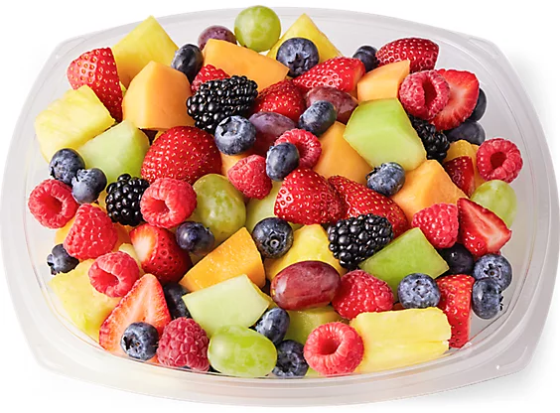
Fellowship Time
Please join us downstairs after worship to enjoy some social time before we depart and share the good news!

Slide 65
St. John’s Lutheran Church
1000 Helena Ave.
Helena, MT 59601
(406) 442-6270
August 3, 2025
Pastor Keith Weatherford, Presiding
(Materials used with permission under One License, License Number A-704356.)

