Slide 1


St. John’s Lutheran Church
1000 Helena Ave.
Helena, MT 59601
(406) 442-6270
July 27, 2025
Pastor Keith Weatherford, Presiding
(Materials used with permission under One License, License Number A-704356.)

Slide 2
St. John’s Lutheran Church
1000 Helena Ave.
Helena, MT 59601
(406) 442-6270
Insert Appropriate
Scrolling Announcements
Sunday Service, 9:30am
20th Sunday After Pentecost
Pastor Keith Weatherford, Presiding
(Materials used with permission under One License, license number A-704356.)
“Growing in Grace, Walking by Faith, Serving in Love”
January 5, 2025

Slide 3
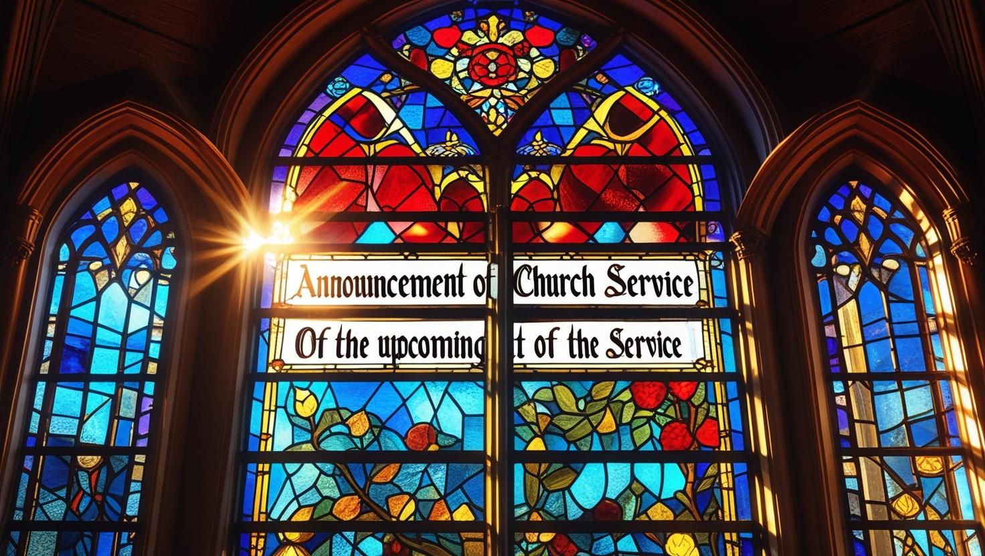
Welcome and Announcements

Slide 4
*Confession and Forgiveness
P:
In the name of the Father, and of the ☩ Son, and of the Holy Spirit.
Amen.
C:

Slide 5
P:
Baptized into Christ, let us confess our sin. Merciful God,
you free us to love others, but we neglect our neighbors and follow our own way. You lead us by the Spirit of joy and peace, but we turn away from the abundant life you offer.
C:

Slide 6
You surround us with patience, kindness, and generosity,
but we grow weary in doing what is right. In your mercy, forgive us.
Do not give up on us. Heal us, break our bonds, and show us the path of life. Amen.

Slide 7
P:
You belong to Christ Jesus
and you are God’s children through faith. In the cross of ☩ Christ, and through the power of the Holy Spirit, your sins are forgiven. Clothed with Christ, you are a new creation.
Amen.
C:

Slide 8
*HYMN: Open Now Thy Gates of Beauty
ELW #533
Verses 1, 2, 5

Slide 9
1. Open now thy gates of beauty,
Zion, let me enter there,
where my soul in joyful duty
waits for God who answers prayer.
Oh, how blessed is this place,
filled with solace, light, and grace!

Slide 10
2. Gracious God, I come before thee;
come thou also unto me;
where we find thee and adore thee,
there a heav'n on earth must be.
To my heart, oh, enter thou,
let it be thy temple now!

Slide 11
5. Speak, O God, and I will hear thee,
let thy will be done indeed;
may I undisturbed draw near thee
while thou dost thy people feed.
Here of life the fountain flows;
here is balm for all our woes.

Slide 12
*Apostolic Greeting
P:
The grace of our Lord Jesus Christ, the love of God,
and the communion of the
Holy Spirit be with you all.
And also with you.
C:

Slide 13
*Prayer of the Day
P: Let us pray. Almighty and ever-living God,
C: you are always more ready to hear than we are to pray, and you gladly give more than we either desire or deserve. Pour upon us your abundant mercy.

Slide 14
Forgive us those things that weigh on our conscience, and give us those good things that come only through your Son, Jesus Christ, our Savior and Lord.
Amen.

Slide 15
First Reading: Psalm 138
Your steadfast love endures forever; do not abandon the works of your hands.
¹ I will give thanks to you, O Lord, with my whole heart;
before the gods I will sing your praise.

Slide 16
² I will bow down toward your holy temple and praise your name, because of your steadfast love and faithfulness;
for you have glorified your name and your word above all things.
³ When I called, you answered me; you increased my strength within me.

Slide 17
⁴ All the rulers of the earth will praise you, O Lord, when they have heard the words of your mouth.
⁵ They will sing of the ways of the Lord,
that great is the glory of the Lord.

Slide 18
⁶ The Lord is high, yet cares for the lowly, perceiving the haughty from afar. ⁷ Though I walk in the midst of trouble, you keep me safe; you stretch forth your hand against the fury of my enemies; your right hand shall save me.

Slide 19
⁸ You will make good your purpose for me; O Lord, your steadfast love endures forever; do not abandon the works of your hands.
L:
The Word of the Lord.
Thanks be to God.
C:

Slide 20
*Gospel Acclamation
(DATH #15)
Al-le-lu-ia, al-le-lu - ia.
Al-le-lu-ia, al-le-lu - ia.
Al-le-lu-ia, al-le-lu - ia.
Al-le-lu-ia, al-le-lu - ia.

Slide 21
*Gospel – Luke 11:1-13
P:
The Holy Gospel according to Luke
beginning with the eleventh chapter and the first verse.
Glory to you, O Lord.
C:

Slide 22
*Gospel – Luke 11:1-13
In teaching his disciples this prayer, Jesus also reminds them to focus on God’s coming reign, God’s mercy, and the strengthening of the community. Jesus encourages his disciples to childlike trust and persistence in prayer.

Slide 23
¹ [Jesus] was praying in a certain place, and after he had finished, one of his disciples said to him, “Lord, teach us to pray, as John taught his disciples.”² So he said to them, “When you pray, say:
Father, may your name be revered as holy. May your kingdom come.

Slide 24
³ Give us each day our daily bread.
⁴ And forgive us our sins, for we ourselves forgive everyone indebted to us. And do not bring us to the time of trial.” ⁵ And he said to them, “Suppose one of you has a friend, and you go to him at midnight and say to him, ‘Friend, lend me three loaves of bread,

Slide 25
⁶ for a friend of mine has arrived, and I have nothing to set before him.’ ⁷ And he answers from within, ‘Do not bother me; the door has already been locked, and my children are with me in bed; I cannot get up and give you anything.’

Slide 26
⁸ I tell you, even though he will not get up and give him anything out of friendship, at least because of his persistence he will get up and give him whatever he needs. ⁹ “So I say to you, Ask, and it will be given to you; search, and you will find; knock, and the door will be opened for you.

Slide 27
¹⁰ For everyone who asks receives, and everyone who searches finds, and for everyone who knocks, the door will be opened. ¹¹ Is there anyone among you who, if your child asked for a fish, would give a snake instead of a fish? ¹² Or if the child asked for an egg, would give a scorpion?

Slide 28
¹³ If you, then, who are evil, know how to give good gifts to your children, how much more will the heavenly Father give the Holy Spirit to those who ask him!”
P: The Gospel of the Lord.
C: Praise to you, O Christ.

Slide 29
Children’s Message and Sermon
Pastor Keith Weatherford,
Presiding
(Silence for Reflection)

Slide 30
*Hymn of the Day:
Seek Ye First WOV # 783
1. Seek ye first the kingdom of God
And His righteousness;
And all these things shall be added unto you.
Hallelu, Hallelujah!

Slide 31
2. Ask, and it shall be given unto you;
Seek, and you shall find.
Knock, and it shall be opened unto you.
Hallelu, Hallelujah!

Slide 32
3. Man shall not live by bread alone,
But by every word
That proceeds out from the mouth of God.
Hallelu, Hallelujah!

Slide 33
*Apostles’ Creed
I believe in God, the Father almighty,
creator of heaven and earth.
I believe in Jesus Christ, God’s only
Son, our Lord, who was conceived
by the Holy Spirit, born of the virgin
Mary, suffered under Pontius Pilate,

Slide 34
was crucified, died, and was
buried; he descended to the dead.*
On the third day he rose again;
he ascended into heaven,
he is seated at the right hand of the
Father, and he will come to judge the living and the dead.

Slide 35
I believe in the Holy Spirit,
the holy catholic Church,
the communion of saints,
the forgiveness of sins,
the resurrection of the body,
and the life everlasting.
Amen.

Slide 36
*Prayers
P: In solidarity with all creation, we join
our voice to the voice of the whole church and pray for the needs of the world.
Prayer Response (each portion of the prayers
end with these words):
P: God of grace,
C: hear our prayer.

Slide 37
*The Peace is Shared
P:
As Christ welcomed everyone,
let us open our hearts and lives and be like Christ to everyone we meet. The peace of the Lord be with you.
And also with you.
C:

Slide 38
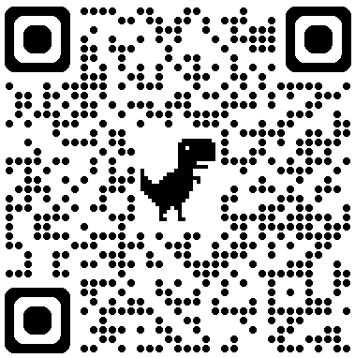
Offering
An offering is gathered for the mission of the church, including care of those in need. Online donations can be made at:
www.helenastjohns.org/donate

Slide 39
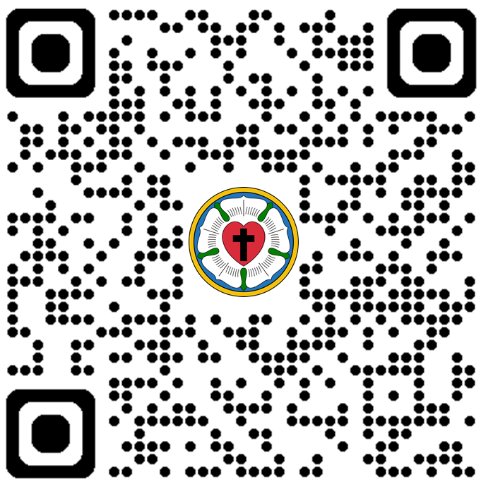
*“OFERTORY HYMN”
Precious Lord, Take My Hand
(ELW #773)

Slide 40
1.
Precious Lord, take my hand,
lead me on, let me stand,
I am tired, I am weak, I am worn.
Through the storm, through the night, lead me on to the light.
Take my hand, precious Lord,
lead me home

Slide 41
2.
When my way grows drear,
precious Lord, linger near.
when my life is almost gone,
hear my cry, hear my call, hold my hand lest I fall.
Take my hand, precious Lord, lead me home.

Slide 42
3.
When the darkness appears and the night draws near,
and the day is past and gone,
at the river I stand, guide my feet, hold my hand.
Take my hand, precious Lord, lead me home.

Slide 43
*Offertory Prayer
P: Let us pray. Creator God,
C: in your wisdom you bring forth all that is good and the harvest is plentiful.

Slide 44
Strengthen us at your table with these gifts of the earth and our labor,
that we may work for the good of all;
through Jesus Christ, our Savior.
Amen.

Slide 45
*The Great Thanksgiving
P:
The Lord be with you.
And also with you.
Lift up your hearts.
We lift them to the Lord.
Let us give thanks to the Lord our God.
It is right to give our thanks and praise.
C:
P:
C:
P:
C:

Slide 46
*Words of Institution
P:
Holy, mighty and merciful God, in great love you sent Jesus your Son, who reached out to heal the sick and suffering, who preached good news to the poor, and who, on the cross, opened his arms to all.

Slide 47
In the night in which he was betrayed, our Lord Jesus took bread and gave thanks; broke it, and gave it to his disciples, saying: Take and eat; this is my body, given for you.
Do this for the remembrance of me.

Slide 48
Again, after supper, he took the cup, gave thanks, and gave it for all to drink, saying: This cup is the new covenant in my blood, shed for you and for all people for the forgiveness of sin.
Do this for the remembrance of me.

Slide 49
Pour out upon us the spirit of your love, O Lord, and unite the will of all who share this heavenly food, the body and blood of Jesus Christ, our Lord: to whom, with you and the Holy Spirit, be all honor and glory, now and forever. Amen.

Slide 50
*The Lord’s Prayer
C:
Our Father in Heaven,
hallowed be your name,
your kingdom come,
your will be done,
on earth as in heaven.
Give us today our daily bread.

Slide 51
Forgive us our sins as we forgive
those who sin against us.
Save us from the time of trial and
deliver us from evil.
For the kingdom, the power, and
the glory are yours, now and
forever.
Amen.

Slide 52
*Invitation to Communion
P:
The Kingdom of God is set before you. Eat and Rejoice.
(We celebrate this meal together at Christ’s table, and all are welcome and encouraged to receive the forgiving and gracious presence of Christ in communion.
Ushers will invite you forward starting from the rear of the sanctuary.)

Slide 53
*Communion Hymn
What a Friend We Have in Jesus
ELW # 742

Slide 54
1. What a friend we have in Jesus,
all our sins and griefs to bear!
What a privilege to carry
ev'rything to God in prayer!
Oh, what peace we often forfeit;
oh, what needless pain we bear--
all because we do not carry
ev'rything to God in prayer!

Slide 55
2. Have we trials and temptations?
Is there trouble anywhere?
We should never be discouraged--
take it to the Lord in prayer.
Can we find a friend so faithful
who will all our sorrows share?
Jesus knows our ev'ry weakness--
take it to the Lord in prayer.

Slide 56
3. Are we weak and heavy-laden,
cumbered with a load of care?
Precious Savior, still our refuge--
take it to the Lord in prayer.
Do your friends despise, forsake you?
Take it to the Lord in prayer.
In his arms he'll take and shield you;
you will find a solace there.

Slide 57
*Prayer After Communion
P:
Let us pray. Mothering God, you gathered us to your table and we drank deeply of your grace. Send us out by your Spirit to love our neighbors as ourselves and proclaim your love in Jesus’ name.
C:
Amen

Slide 58
*Litany of Sending
Acts 13:2, “While the congregational leaders at Antioch were worshipping the Lord and fasting, the Holy Spirit said, “Set apart for me Barnabas and Saul for the work to which I have called them.” Then after fasting and praying they laid hands on them and sent them off.”

Slide 59
P: Today we send forth Micah Langdji, who has been chosen to serve as a delegate to the ELCA Churchwide Assembly. This gathering brings together the people of God from across the country to discern, discuss and decide how we will walk together in mission as Christ’s church.

Slide 60
P: People of God, will you support and pray for Micah in this work?
C: We will and we ask God to help us.
P: Let us join together,
C: Micah, we give thanks for your willingness to serve, to listen, and to lead. Go with our prayers and our blessing.

Slide 61
P: Micah, as you go from this place to represent our congregation and synod, do so with a heart open to the Spirit’s leading, a mind attentive to God’s Word, and a voice ready to speak with truth and grace.
Micah: I will and ask God to help and Guide me.

Slide 62
P: Let Us Pray. Gracious God, you call your people to service and give them varied tasks in the world and in your church. Grant Micah grace and strength, that he may serve you faithfully to the glory of your name; through your Son, Jesus Christ, our Savior and Lord.
C: Amen

Slide 63
P: Micah, we bless you as you go. May Christ go before you to guide your way, behind you to encourage you, beside you to befriend you, and within you to give you peace.

Slide 64
*Blessing
P:
The love of God abound in you; the grace of our Savior Jesus Christ fill your hearts; and the life of the Spirit ☩ bless you and give you peace.
C:
Amen

Slide 65
“Your Will Be Done” ELW # 741
Sing Twice
Your will be done on earth, O Lord.
Sing 5 times

Slide 66
*Dismissal
P:
Go in peace. Live by the Spirit.
Thanks be to God.
C:
“Growing in Grace, Walking by Faith, Serving in Love”

Slide 67

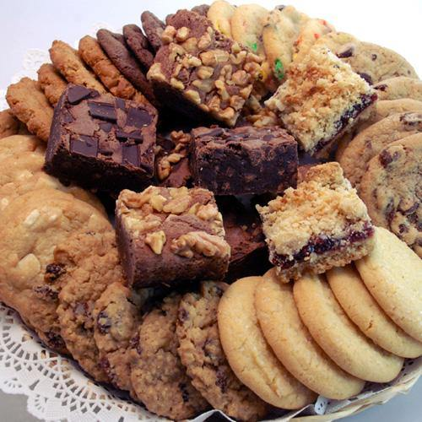
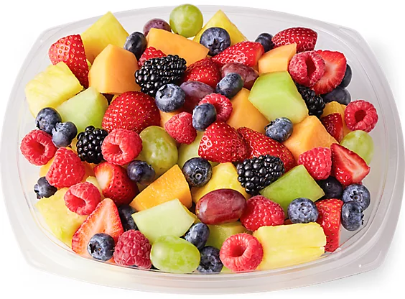
Fellowship Time
Please join us downstairs after worship to enjoy some social time before we depart and share the good news!

Slide 68
St. John’s Lutheran Church
1000 Helena Ave.
Helena, MT 59601
(406) 442-6270
July 27, 2025
Pastor Keith Weatherford, Presiding
(Materials used with permission under One License, License Number A-704356.)

